Slide 1
COMP 3617
Week 2

Slide 2
Outline
Android Application Fundamentals
Overview of Manifest File
Activities
Activity Life Cycle
Intent
Using Intents to perform common operations

Slide 3
App Fundamentals
Apps are written in Java
Android SDK tools compile code into an Android package (.apk) - an archive file
Each application, when installed, lives in its own security sandbox
From Linux perspective, each app is assigned a unique user ID and as such can only access files associated with that user
Each App runs in its own VM
Every application run in its own Linux process

Slide 4
App Fundamentals
Android starts the process when any of the app’s components need to be executed
Android shuts down the process when its no longer needed or to save resources
Each app has access only to the components that it requires to do its work and no more – Principle of Least Privilege
An app can request permission to access device data (e.g.: user contacts, SMS messages, SD card, camera, etc)
Permissions must be granted by user at install time of the app (this has changed in Marshmallow)

Slide 5
How Android apps are different?
Unlike desktop applications, there is no single point of entry for Android apps
If you look at the source code of an Android app, there is no main() which is typical in a Java application
Apps are made up of one or more of the components – Activities, Services, Broadcast Receivers and Content Providers
Components interact with one another to create an app

Slide 6
How Android apps are different?
Components of the app are initiated and started up by the Android OS when certain tasks need to be performed or react to certain events in the system
Other applications can invoke these components within the permission levels granted by the user
Components have a life cycle associated with them and the Android OS aggressively manages these components to provide optimum experience to the user

Slide 7
How Android apps are different?
Programming for Android is different from other environments like Java Swing, AWT
Most of the code involves responding to state changes in the app
If you have programmed with applets/servlets, you can see some parallels – as these are container managed

Slide 8
Building blocks of Android App
Android Application
Manifest.xml
Intents
Resources
Activities
Services
Content Providers
Broadcast Receivers

Slide 9
Android App Components
Major building blocks of an App
Could serve as an entry point to the app
Four types of application components
Component Name | Description
Activities | Represents a single screen with a user interface. Eg: an email app shows list of new emails in one activity and another activity to compose the email
Services | Run in the background to perform long-running operations. Does not provide a user interface
Content Providers | Provides an interface to manage a shared set of application data Eg: user contact information
Broadcast receivers | Responds to system wide broadcast announcements. Broadcasts can originate from the system – eg: screen is turned off. Or can be initiated by an application
Notes:
There is fifth Component called Application but rarely used

Slide 10
Android App Components
Any application can start another application’s component
Eg: There is already an app to capture a photo via the camera and if your app needs to capture a photo, you just use that app
When Android needs to start a component, it first starts the process hosting that component (if it’s not already running) and then instantiates the classes for the component

Slide 11
How are components activated?
By an asynchronous message called an “Intent”
Intents bind individual components at runtime, irrespective of which app hosts the component
An Intent defines a message to the Android OS to activate either a specific component (explicit) or a specific type of component (implicit)
Intents are very different from calling API’s which require compile time dependency

Slide 12
Android Studio Project Structure
Typical Android Project has a number of folders – some specific to Java source and others are auto-generated
Most auto-generated XML files are application’s resources
Folder generated contains auto-generated code (most important one being R.java)
More details on resources next week
An Android app always has a Manifest file (xml) at the root of the application project directory

Slide 13
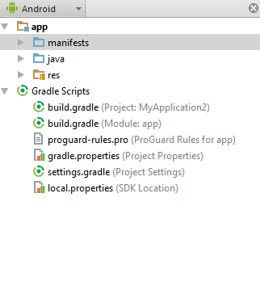
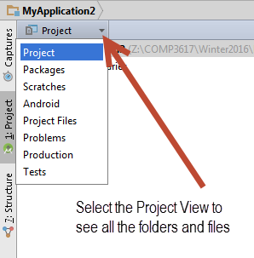
Android Studio Project Structure
Android Studio uses Android View by default for every Project
Android view hides a lot of the details of the folder structure of an Android Project

Slide 14
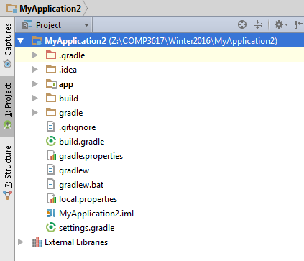
Android Studio Project Structure
The Project view shows all the folders and files for the Project
A lot of the files you see here are not shown in Android View

Slide 15
Android Studio Project Structure
Android Studio Project is made up of modules
When a Project is created, the first module is automatically created
“app” is the main module and contains the application
Top-level build.gradle specifies the settings for the Android Studio Project
Most importantly is the “app” folder which contains the app and has information specific to the app

Slide 16
App folder
Here are the important folders and files
Folder/File | Description
build | Contains generated and temporary files
build.gradle | Instructions to compile the app
libs | For 3rd party jars
src/main | Source files for the app
src/androidTest | Test cases to test the app
AndroidMainifest.xml | Defines the android app – its components, permissions and more

Slide 17
Manifest file
Components of an app are declared in the Manifest file
Android OS reads the Manifest file to determine the capabilities of your app
Contains any user permission the app requires Eg: contacts list, access to internet, GPS, Calendar etc
Hardware/Software features required by app – Camera, bluetooth services, etc

Slide 18
Manifest Element
Top-level element is manifest
Contains package attribute which uniquely identifies the application
Typical convention is to use reverse domain name for your organization appended with a lower case name of the application
Other things that you can specify as attributes of manifest are location for the APK, Linux user id under which the app runs, etc

Slide 19
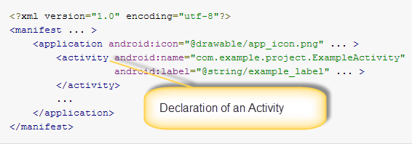
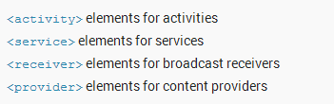
Manifest File – Declaring Components
Allows for Component Registration

Slide 20
Manifest File – Declaring Component Capabilities
Components also need to advertise their capabilities to the Android OS
This allows the system to identify the components that can respond to an intent
When declaring a component, an optional intent filter can be provided to declare the capabilities of the component

Slide 21
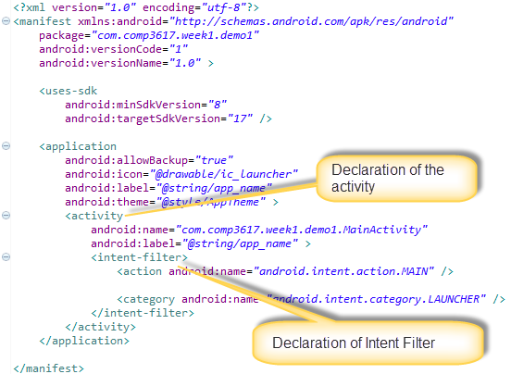
Manifest file from our sample app

Slide 22
Manifest File – Declaring app requirements
Apps require software and hardware (camera, bluetooth, GPS) features to be available on the device
Defines a profile of the type of devices and software capabilities the app requires so Google Play can filter them out for devices that don’t have those capabilities
Eg: If the app requires a camera and uses APIs introduced in Android 2.1, then the app should declare those requirements in the manifest file

Slide 23
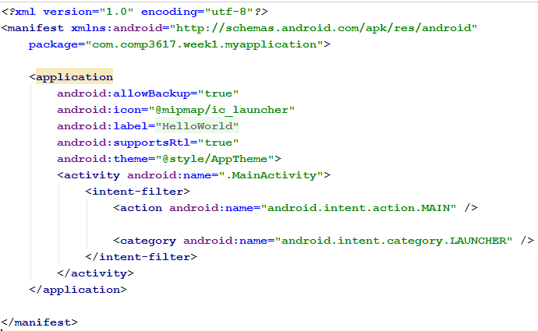
Sample Manifest file

Slide 24
Gradle
General purpose build tool like Ant
Support for multi-project builds
Dependency management – both existing Maven and Ivy repository infrastructure
Provides a DSL (Domain Specific Language) using Groovy language
Supports plugins for extensibility
Android Studio uses Gradle with its custom plugin to build Android apps
Vast topic – hence our focus will be minimum

Slide 25
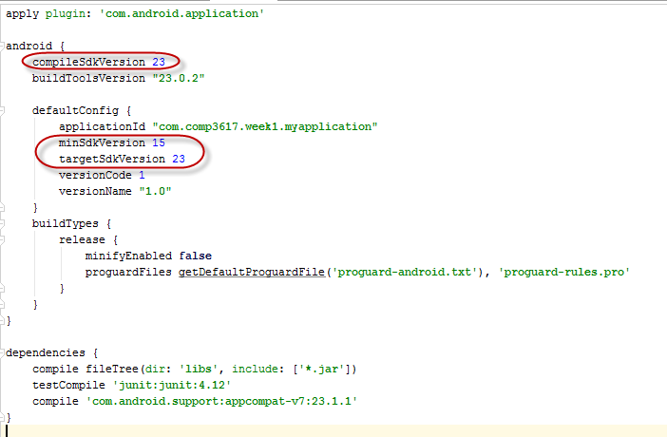
App’s build.gradle

Slide 26
SDK Versions
Compile SDK version | Version that you compile the application with. Usually the highest version available
Minimum SDK version | Lowest version of Android device’s platform that can successfully run the app. Google Play store filters the apps that can be run a specific device based on this setting. The higher this setting, the lower the number of devices that can run the app. If this number is too low, then one cannot take advantage of the new capabilities in the newer versions of Android
Target SDK version | This is the version of Android that the app has been successfully tested on. Always set this value to the latest version of Android

Slide 27
Activity
Activity = Single Screen of interaction
Fundamental building block of Android app
User interface that provides a screen with which users interact
Eg: Take a photo, Send an email, View a map
App consists of multiple activities that are loosely bound to each other
Typically one activity in an app is specified as the “main” activity – which is presented to the user when the app is launched

Slide 28
Activity
Can exist in a number of states and has a life cycle associated with it
Inherits from the abstract Context class
Context get a reference to the current application and provides access to Android system

Slide 29
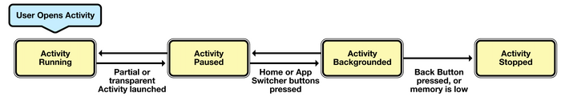
Activity States
An activity can be in one of the following states during its life time
Running – Activity is in the foreground
Paused – When the activity is partially hidden by a new activity
Stopped/Backgrounded – Completely obscured by another activity

Slide 30
Activity States
Restarted – An activity that is paused or stopped can be removed from memory by Android and if the user navigates back to the activity, it is restarted by Android

Slide 31
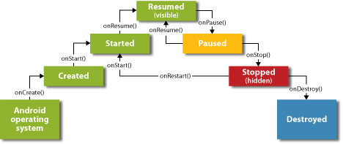
Activity Lifecycle

Slide 32
Events that trigger lifecycle changes
Changing screen orientation destroys and re-creates activity from scratch
Pressing Home button pauses the activity but does not destroy it
Allowing the screen to sleep pauses the activity
Pressing the app icon might start a new instance of the activity in spite of an existing one that is not destroyed

Slide 33
Activity Lifecycle Methods
Method Name | Description
OnCreate | Inflates views and puts them on the screen. Get references to inflated views. Set listeners on views. All set up information goes here
OnStart | Called when activity comes to foreground after being launched first time or when brought back to the foreground after having been hidden
OnResume | Called just before the activity comes to the foreground. Good place to acquire resources needed for the app
OnPause | Called when a new activity leaves the foreground. Good place to release exclusive resources
OnStop | Called when the activity is about to be stopped
OnDestroy | May be called when the activity is shutting down either because finish() method is called on activity or Android closes the activity for reclaiming memory resources
OnRestart | Called when the activity has been stopped and is now restarting. Followed by onStart() and onResume()

Slide 34
Logging in Android
Android provides logging capability
API is similar to Log4j
Logging is done via Log.d(TAG, msg) where TAG is something specific to your app
TAG could be the name of the app or activity and can be used for filtering the log messages
Log takes different severity levels – debug, error, warning, info and even wtf! (what a terrible failure…)

Slide 35
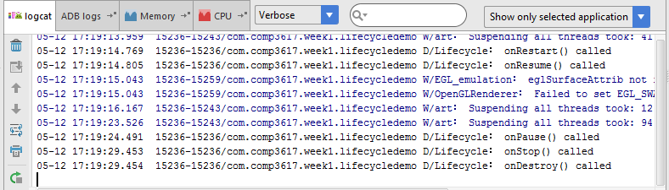
Logging in Android

Slide 36
Intent
Message passing infrastructure in Android
Used to invoke components within the application and across applications
Intents are commonly used for
Start a service or activity (explicitly or implicitly)
Broadcast an event
Explicit intent specifies the class to receive the intent
Implicit intent requests Android to perform an action

Slide 37
Intent
Android system uses intents to broadcast messages across the system
An Intent in the API is just a class in android.content package
Intents can be used to launch Activities via startActivity(intent) method
Intent can carry data as extras as it provides a dictionary like interface
Extras are a mechanism to attach primitive values to an Intent

Slide 38
Some uses of Intent
Activity transition
Data Transfer from one component to other
Sending SMS and MMS
Sending e-mails and social media posts
Accessing Camera
Handling broadcast messages
And others…

Slide 39
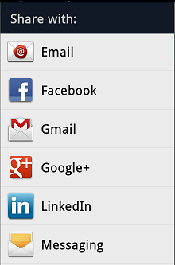
Share Intent - Common Example
A common task is the sharing of information via email, messaging, social networking, etc
The intent for this is Share Intent which brings up the available options

Slide 40
Activity Transition
Activities can launch other activities within the same app
Typically use explicit intents for this via the startActivity() API call
Sub Activities can return results to the calling activity via setResult() API call
To obtain the result and status from calling activity, the parent activity should override the onActivityResult() API call

Slide 41
Intent
An Intent has
Action – specifies the action that needs to be performed (string or predefined constant)
Component – target component to process the intent
Data – URI of the data to be acted on
Type – MIME type of data to be acted on
Category – Grouping mechanism for intents
Flags – extra information to define the processing
Extras – Key-value pairs of extra data to process the intent

Slide 42
Receiving and Sending Intents
Two ways to inform Android system that your app would like to receive intents sent out by other apps, Android system or your own app
Declaring an intent-filter in manifest file
Programmatically at runtime via IntentFilter object
When you send out an intent, you broadcast it to the whole system or specifically to a component

Slide 43
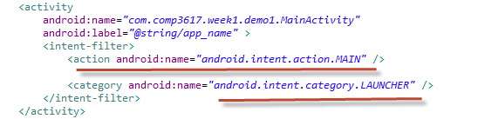
Intent Filters
Within an activity you can add intent-filter nodes that specify the intents that can start the activity
Each intent filter specifies one or more actions and categories
For an activity to be available from the application launcher, it should have a MAIN action and LAUNCHER category

Slide 44
Intent Filters
Specifies what types of intent the component can receive
To register an activity as an intent handler, you should add an intent-filter with the following information
Action – Specify android:name attribute.
Category – Specify android:name attribute
Data – Specify the data type your component can act on

Slide 45
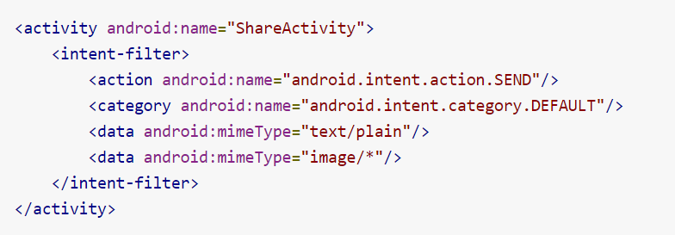
Intent Filters

Slide 46
Intent Resolution
Intent is an abstract description of some operation
When an intent is sent, Android has to determine where the Intent should be delivered – this is called Intent Resolution
With explicit intents, there can only be one receiver, so is straight forward
With implicit intents, the intent resolution mechanism depends on action, data URI/type and category

Slide 47
Intent Action
Each intent filter should specify at least one action tag
There are a number of predefined action in Android and an app can define its own
Actions are strings that self-describing.
Standard is to use Java package naming convention Eg:android.intent.action.MAIN
Actions have to be unique, hence the Java package naming convention

Slide 48
Intent Data
Enables an action performed by a component
Carries with additional data required for the action
For Eg: ACTION_CALL requires data for the telephone number
Data is given to the intent in the form of URI (Eg: tel:604-123-4567)

Slide 49
Intent Category
An intent filter can have multiple category tags
Commonly used Category is LAUNCHER to make an activity appear in the application launcher
DEFAULT is used for activities that are launched by explicit intent

Slide 50
Intent Extras
An activity should never reference another’s activity’s data directly and instead should rely on intent to carry the data
An intent can carry data along with it and should be the mechanism
Intent has an Extra bundle which can store string-primitive pairs
A sending component (say Activity1) can pass data to another component (say Activity2) and the second activity can retrieve the data contained in the intent

Slide 51
Toast
Log class is a common way to output log messages via the LogCat buffers – but this information shows up outside the app in Android Studio or a console window
To display short messages in the app itself, you make use of a Toast class
A Toast is a short message show to the user as a small floating pop-up on top of your app at the bottom of the screen

Slide 52
Launching Common Apps
Intents can be used within an app to launch other activities inside the app
Intents can also launch other apps that are available on the platform
Native applications – like dialer, phone, map, market can be launched easily via the Intent
When multiple apps can perform a given action, the user is presented with a choice
Third party apps can provide an alternate provider for common native apps

Slide 53
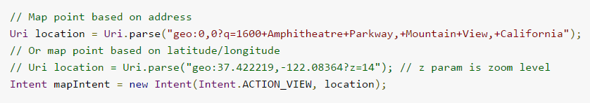

Using Intents for Common Operations
View a Map
View a web page
Notes:
There are other examples in the Android documentation

Slide 54
Application Class
Every app has a singleton Application class associated with it
Android allows you to override and provide your own custom Application class
The Application has onCreate method that gets called only once the first time an app is launched – gives you an opportunity to do app specific initialization
You can retrieve the Application instance via getApplication() on the activity

